Slide 1

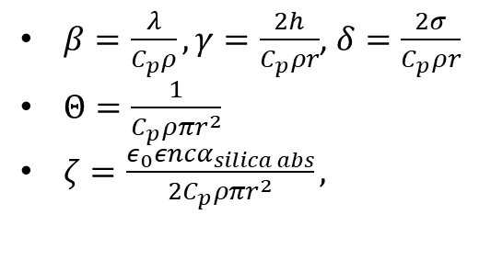
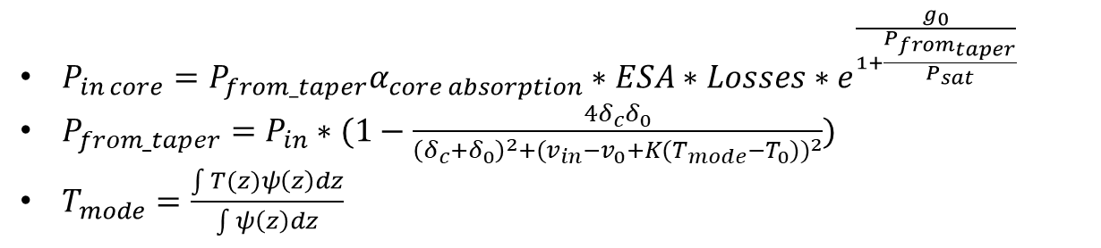
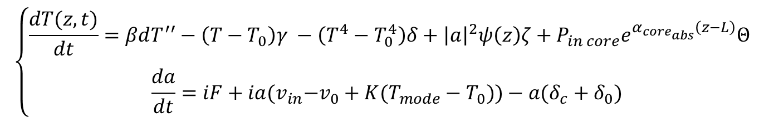
$$\left\{\begin{aligned}\frac{dT(z,t)}{dt}=βdT^{′′}−\left(T−T_{0}\right)γ −\left(T^{4}−T_{0}^{4}\right)δ+{\left|a\right|}^{2}ψ\left(z\right)ζ+P_{in core}e^{α_{core_{abs}}\left(z−L\right)}Θ \\ \begin{matrix} \\ \frac{da}{dt}=iF+ia{(v}_{in}−v_{0}+K(T_{mode}−T_{0}))−a(δ_{c}+δ_{0})\end{matrix} \end{aligned}\right.$$
$P_{in core}={P_{from_taper}α}_{core absorption}∗ESA{∗Losses∗e}^{\frac{g_{0}}{1+\frac{P_{from_{taper}}}{P_{sat}}}}$
$P_{from_taper}=P_{in}∗(1−\frac{4δ_{c}δ_{0}}{\begin{aligned}{\left(δ_{c}+δ_{0}\right)}^{2}{+{(v}_{in}−v_{0}+K(T_{mode}−T_{0}))}^{2}\end{aligned}})$
$T_{mode}=\frac{\int{T(z)}ψ\left(z\right)dz}{\int{ψ\left(z\right)dz}}$
$β=\frac{λ}{C_{p}ρ},γ=\frac{2h}{C_{p}ρr}$, $δ=\frac{2σ}{C_{p}ρr}$
$Θ=\frac{1}{C_{p}ρπr^{2}}$
$ζ=\frac{ε_{0}εncα_{silica abs}}{2C_{p}ρπr^{2}},$

